Slide 1
Algebra of Matrices

Slide 2
Addition and Subtraction of Matrices

Slide 3
Addition and Subtraction of Matrices
In addition to being convenient for solving systems of
equations, matrices are useful tools for modeling problems
in business and science.
One prevalent application of matrices is to spreadsheet programs.
The typical method used in spreadsheets is to number the rows as 1, 2, 3, . . . and to identify the columns as
A, B, C,….

Slide 4
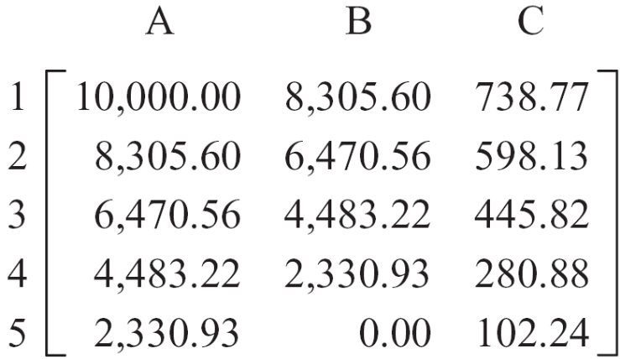
Addition and Subtraction of Matrices
The partial spreadsheet below shows how a consumer’s car loan is being repaid over a 5-year period.
The elements in column A represent the loan amounts, in dollars, at the beginning of each year; column B represents the amount owed at the end of each year; and column C represents the amount of interest paid during the year.
For instance, the element
in 3C means that the consumer
paid $445.82 in interest during
the third year of the loan.

Slide 5
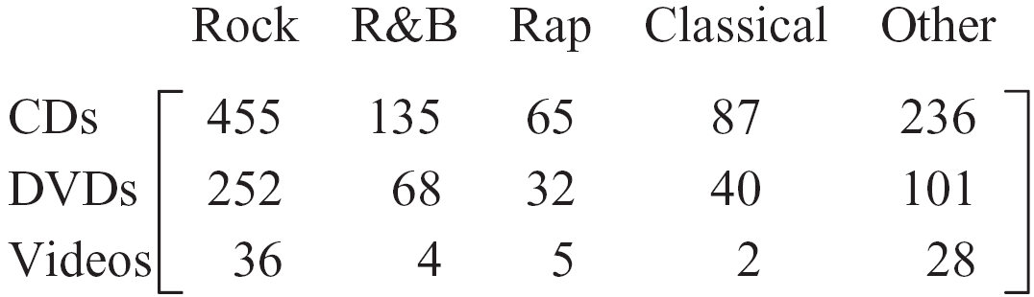
Addition and Subtraction of Matrices
Matrices are effective for modeling situations in which there
are a number of items to be classified.
For instance, suppose a music store has sales for January
as shown in the following matrix.
This matrix indicates, for instance, that the music store sold
40 classical DVDs in January.

Slide 6
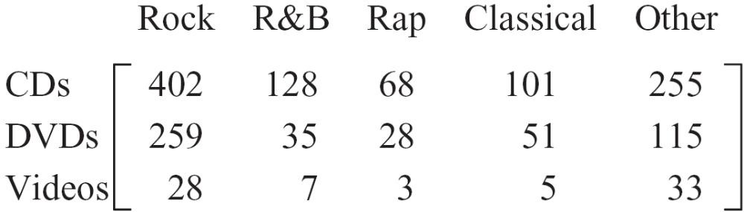
Addition and Subtraction of Matrices
Now consider a similar matrix for February.
Looking at this matrix and the matrix for January reveals that the number of R&B DVDs sold for the two months is
68 + 35 = 103.

Slide 7
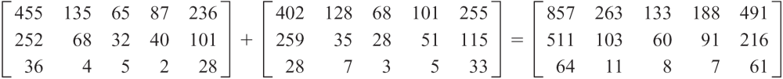
Addition and Subtraction of Matrices
By adding the elements in corresponding cells, we obtain the total sales for the two months. In matrix notation, this would be shown as
In the matrix that represents the sum, 857 (in row 1, column 1) indicates that a total of 857 rock music CDs were sold in January and February.
Similarly, a total of 91 (in row 2, column 4) classical DVDs were sold for the two months.

Slide 8
Addition and Subtraction of Matrices
This example suggests that the addition of two matrices should be performed by adding the corresponding elements.
Before we actually state this definition, we first introduce some notation and a definition of equality.
A matrix will be indicated by using a capital letter or by enclosing a lowercase letter in brackets. Thus a matrix can be denoted as
A or [a_{ij}]

Slide 9
Addition and Subtraction of Matrices
An important concept involving matrices is the definition of
the equality of two matrices.
Definition of Equality of Two Matrices
Two matrices A = [a_{ij}] and B = [b_{ij}] are equal if and only if
a_{ij} = b_{ij}
for every i and j.

Slide 10

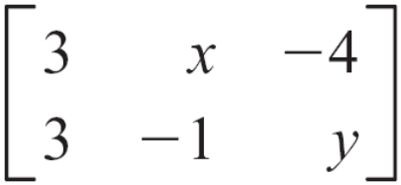
Addition and Subtraction of Matrices
Example
Let A = and B = .
Then A = B if and only if a = 3, x = –2, b = –4, c = –1,
and y = 1.

Slide 11
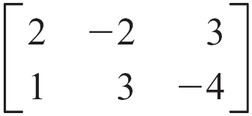
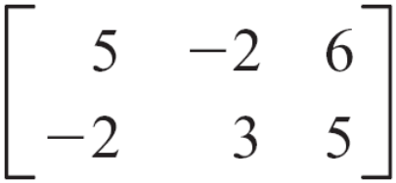
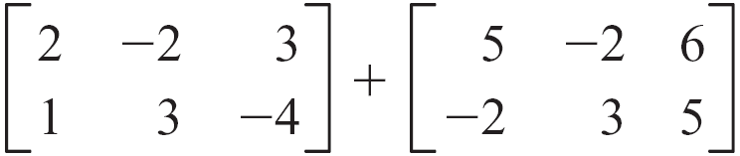
Addition and Subtraction of Matrices
Definition of Addition of Matrices
If A = [a_{ij}] and B = [b_{ij}] are matrices of order m × n, then the
sum of the matrices is the m × n matrix given by
A + B = [a_{ij} + b_{ij}]
Example
Let A = and B = . Then
A + B =

Slide 12
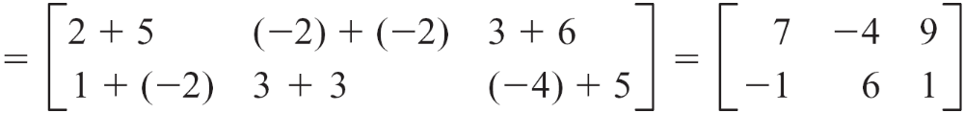
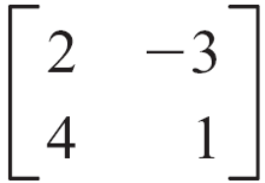
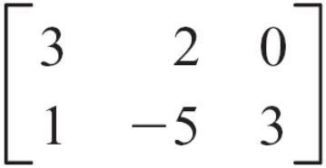
Addition and Subtraction of Matrices
Now let C = and D = .
Here C + D is not defined because the matrices do not have the same order.

Slide 13
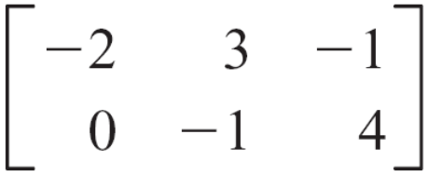
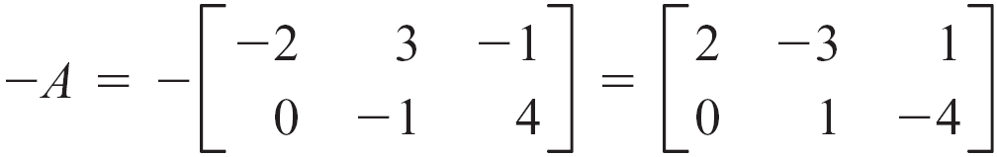
Addition and Subtraction of Matrices
To define the subtraction of two matrices, we first define the additive inverse of a matrix.
Definition of the Additive Inverse of a Matrix
Given the matrix A = [a_{ij}], the additive inverse of A is
–A = [–a_{ij}].
Example
Let A = . Then the additive inverse of A is

Slide 14
Addition and Subtraction of Matrices
Subtraction of two matrices is defined in terms of the
additive inverse of a matrix.
Definition of Subtraction of Matrices
If A and B are two matrices of order m × n, then A – B is the
sum of A and the additive inverse of B.
A – B = A + (–B)

Slide 15
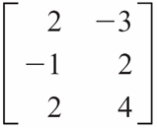
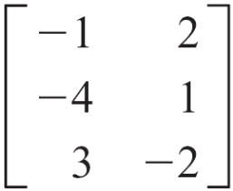
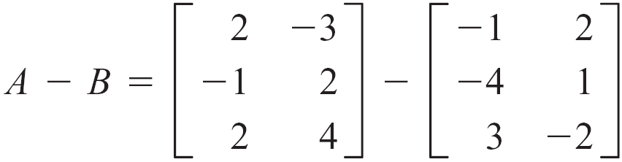
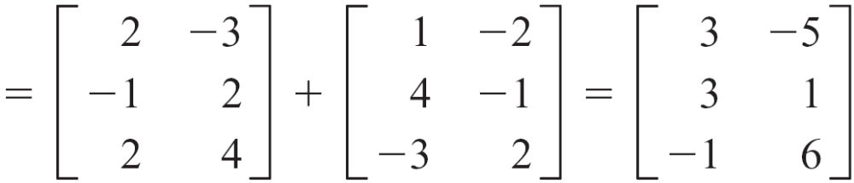
Addition and Subtraction of Matrices
Example
Let A = and B = . Then

Slide 16
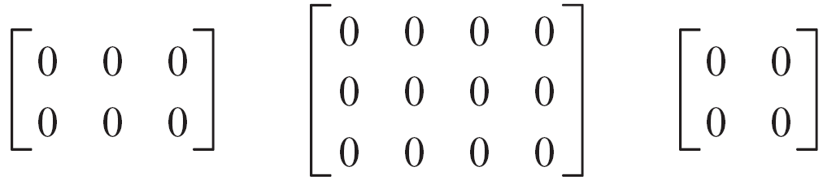
Addition and Subtraction of Matrices
Of special importance is the zero matrix, which is the matrix that consists of all zeros. The zero matrix is the additive identity for matrices.
Definition of the Zero Matrix
The m × n zero matrix, denoted by O, is the m × n matrix whose elements are all zeros.
Example
The following matrices are zero matrices.

Slide 17
Addition and Subtraction of Matrices
Properties of Matrix Addition
Given matrices A, B, and C and the zero matrix O, each of order m × n, the following properties hold.
Commutative A + B = B + A
Associative A + (B + C) = (A + B) + C
Additive inverse A + (–A) = O
Additive identity A + O = O + A = A

Slide 18
Scalar Multiplication

Slide 19
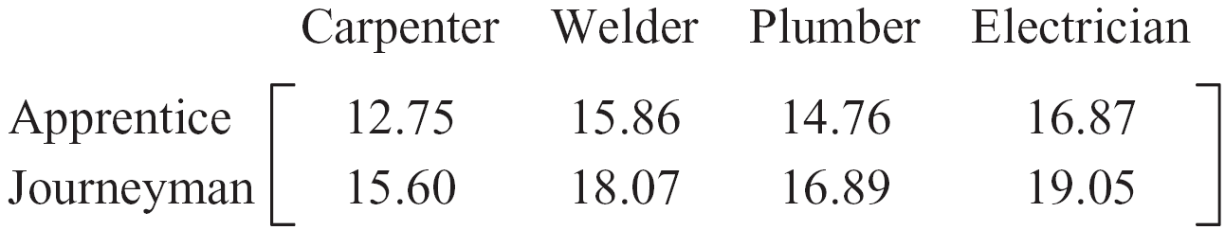
Scalar Multiplication
Two types of products involve matrices. The first product
we will discuss is the product of a real number and a
matrix.
Consider the matrix below, which shows the hourly wages, in dollars, for various job classifications in a construction firm before a 6% pay increase.

Slide 20
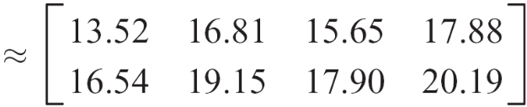
Scalar Multiplication
After the pay increase, the pay in each job category will increase by 6%. This can be shown in matrix form as
The element in row 1, column 4 indicates that an apprentice electrician will earn $17.88 per hour after the pay increase.
This example suggests that, to multiply a matrix by a constant, we multiply each entry in the matrix by the constant.

Slide 21
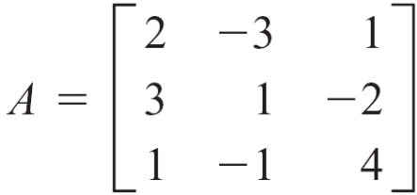
Scalar Multiplication
Definition of the Product of a Real Number and a Matrix
Given the m × n matrix A = [a_{ij}] and the real number c,
then cA = [ca_{ij}].
Finding the product of a real number and a matrix is called scalar multiplication.
As an example of this definition, consider the matrix
and the constant c = –2.

Slide 22
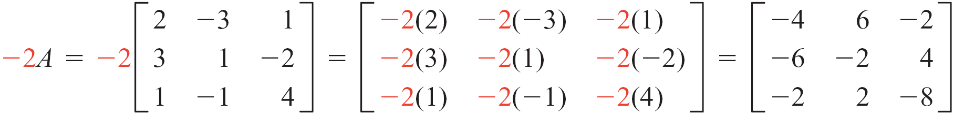
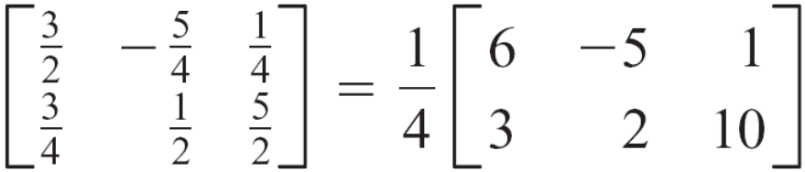
Scalar Multiplication
Then
This definition is also used to factor a constant from a matrix.

Slide 23
Scalar Multiplication
Properties of Scalar Multiplication
Given real numbers a, b, and c and matrices A = [a_{ij}] and
B = [b_{ij}], each of order m × n, then
Distributive property
(b + c)A = bA + cA
c(A + B) = cA + cB
Associative property
a(bA) = (ab)A
Right distributive property
Left distributive property

Slide 24
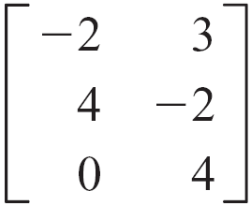
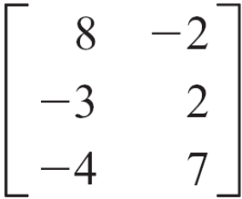
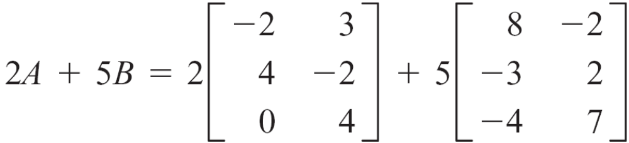
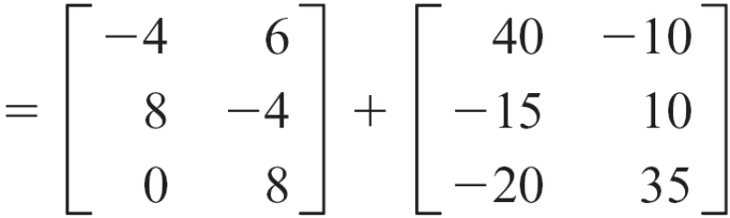
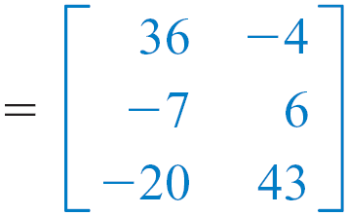
Example 1 – Find the Sum of Two Scalar Products
Given A = and B = , find 2A + 5B.
Solution:

Slide 25
Matrix Multiplication

Slide 26
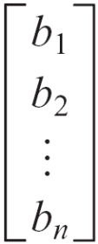
Matrix Multiplication
We now turn to the product of two matrices. We begin with the product of a row matrix and a column matrix.
Definition of the Product of a Row Matrix and a Column Matrix
Let A be the 1 × n row matrix A = [a₁ a₂ … a_{n} ] and let B
be the n × 1 column matrix B = .

Slide 27
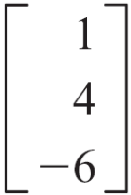
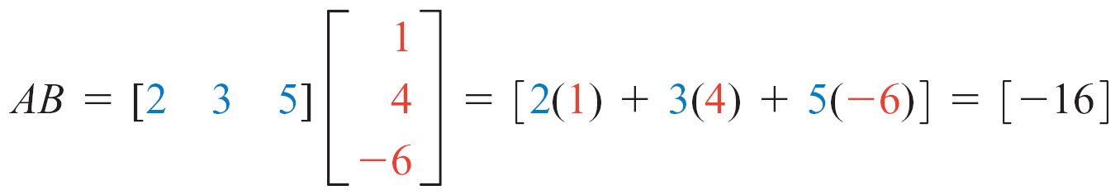
Matrix Multiplication
Then the product of A and B is
AB = [a₁ a₂ … a_{n}] = [a₁b₁ + a₂b₂ + … + a_{n}b_{n}]
Example
Let A = [2 3 5] and B = . Then

Slide 28
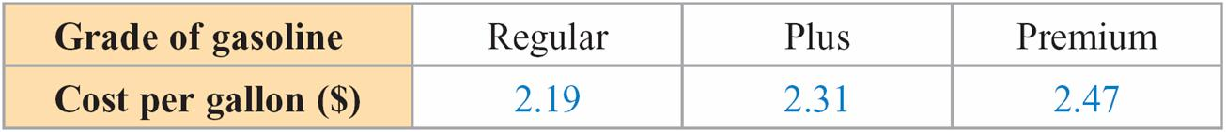
Matrix Multiplication
The motivation for the definition of the product of a row and a column matrix can be illustrated by the following example.
Suppose that the cost per gallon of gasoline to a gas station owner on a certain day is given in the table below.

Slide 29
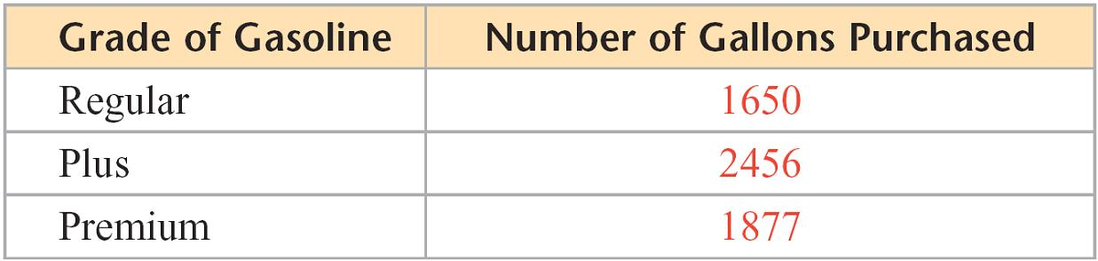
Matrix Multiplication
The number of gallons of gasoline purchased by the owner on that day is given in the following table.
The total cost, in dollars, of the gasoline purchased by the owner was
2.19(1650) + 2.31(2456) + 2.47(1877) = 13,923.05

Slide 30
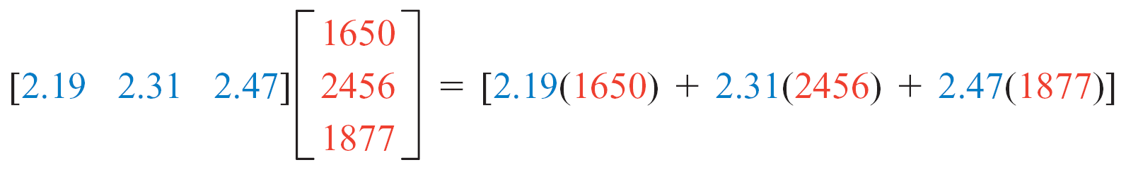

Matrix Multiplication
Note that the total cost 13,923.05 is the single element of the product of the row matrix of gasoline prices and the column matrix of the number of gallons of each type of gasoline purchased.
The definition of the product of two general matrices is an extension of the definition of the product of a row and a column matrix.

Slide 31
Matrix Multiplication
Definition of the Product of Two Matrices
Let A = [a_{ij}] be a matrix of order m × n and let B = [b_{ij}] be a matrix of order n × p.
Then AB = [c_{ij}] is a matrix of order m × p, where c_{ij} (the element in the ith row and the jth column) is determined by multiplying each element in the ith row of A by the corresponding element in the jth column of B and adding the products.
c_{ij} = a_{i1} b_{1j} + a_{i2} b_{2j} + . . . + a_{in} b_{nj}

Slide 32
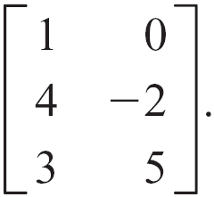

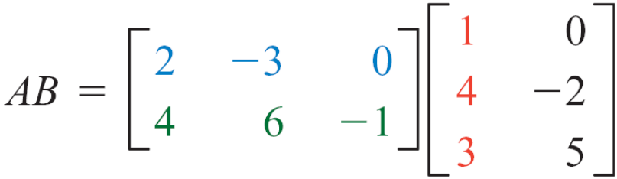
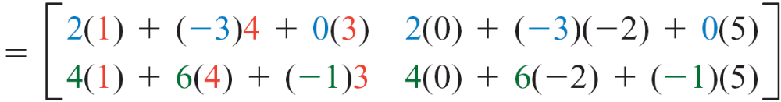
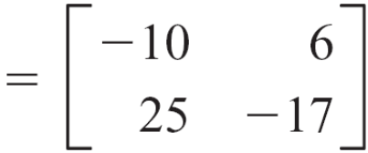
Matrix Multiplication
Example
Let A = and B = Then

Slide 33
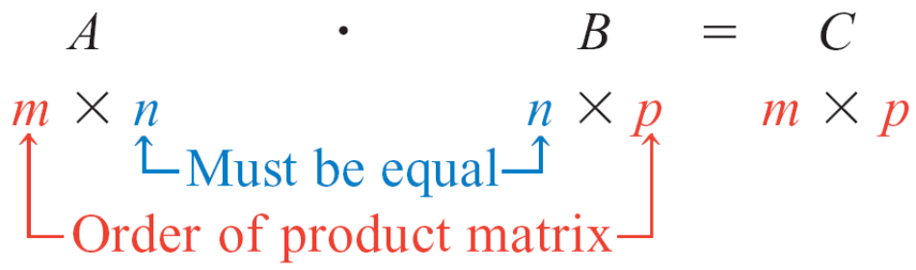
Matrix Multiplication
For the product of two matrices to be defined, the number
of columns of the first matrix must equal the number of
rows of the second matrix.

Slide 34
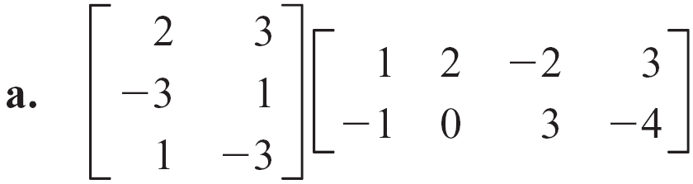
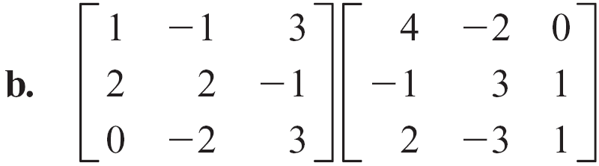
Example 2 – Find the Product of Two Matrices
Find each product.

Slide 35
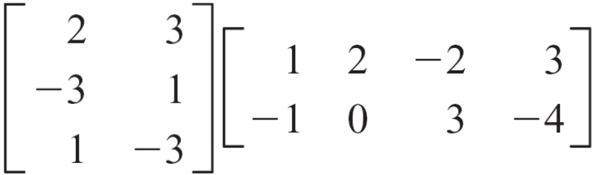
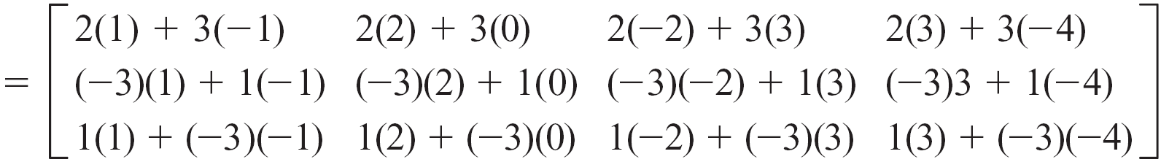
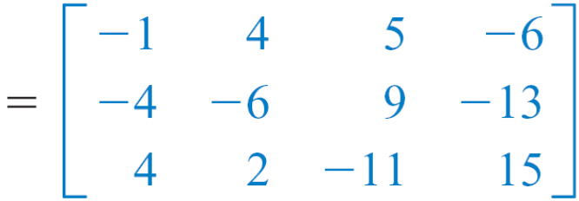
Example 2(a) – Solution

Slide 36
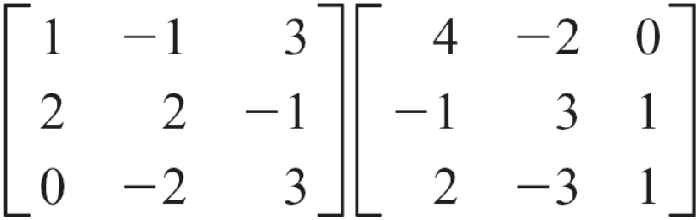
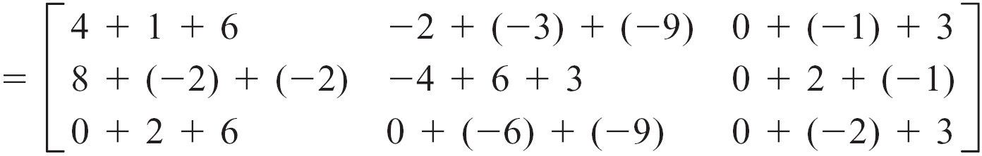
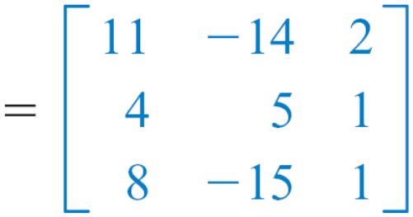
Example 2(b) – Solution
cont’d

Slide 37
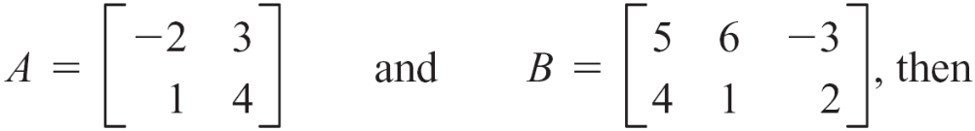
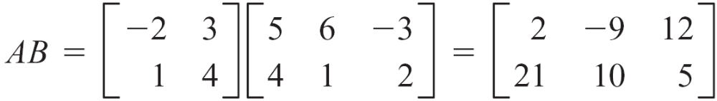
Matrix Multiplication
Generally, matrix multiplication is not commutative. That is, given two matrices A and B, AB ≠ BA. In some cases, if we reverse the order of the matrices, the product will not be defined.
For instance, if

Slide 38
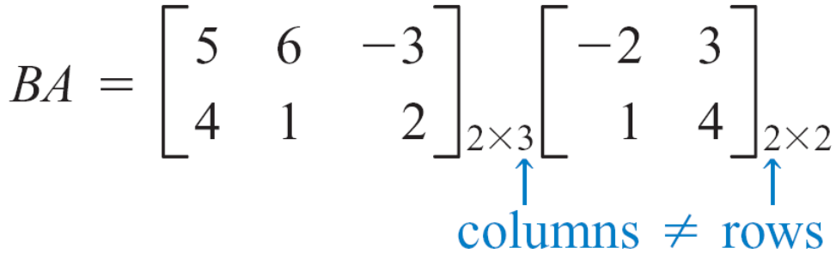
Matrix Multiplication
However, BA is undefined because the number of columns
of B does not equal the number of rows of A.
Even in cases where multiplication is defined, the products
AB and BA may not be equal.

Slide 39



Matrix Multiplication
For instance, if
Thus, in this example, AB ≠ BA.

Slide 40

Matrix Multiplication
A square matrix that has a 1 for each element on the main
diagonal and zeros elsewhere is called an identity matrix.
The identity matrix of order n, denoted I_{n}, is the n × n
matrix

Slide 41

Matrix Multiplication
The identity matrix has properties similar to those of the
real number 1.
For example, the product of the matrix A below and I₃ is A.
Multiplicative Identity Property for Matrices
If A is a square matrix of order n and I_{n} is the identity matrix
of order n, then AI_{n} = I_{n} A = A.

Slide 42
Matrix Products and Systems of Equations

Slide 43


Matrix Products and Systems of Equations
Consider the system of equations
2x + 3y – z = 5
x – 2y + 2z = 6
4x + y – 3z = 5
This system can be expressed as a product of matrices, as follows.
Equality of matrices

Slide 44


Matrix Products and Systems of Equations
Reversing this procedure, certain matrix products can represent systems of equations.
Consider the matrix equation
Definition of matrix multiplication

Slide 45

Matrix Products and Systems of Equations
4x + 3y – 2z = 2
x – 2y + 3z = –1
x + 5z = 3
Performing operations on matrices that represent a system of equations is another method of solving systems of equations.
Definition of matrix multiplication
Equality of matrices

Slide 46



Example 3 – Write a System of Equations from a Matrix Equation
Write the matrix equation as a
system of equations.
Solution:

Slide 47

Example 3 – Solution
cont’d
Using equality of matrices, we have the system of equations
2x + 3y + z = 0
– y + 4z = –2
5x – 3y + 4z = 8

Slide 48
Applications of Matrices
Matrices often can be used to solve applications in which a sequence of events repeats itself over a period.
For instance, the following application is from the field of botany.
A biennial plant matures 1 year after a seed is planted. In the second year the plant produces seeds that will become the new plants in the third year, and then the 2-year-old plant dies.
Suppose that a wilderness area currently contains 500,000 of a certain biennial and that there are 225,000 plants in their first year and 275,000 in their second year.

Slide 49

Applications of Matrices
Suppose also that 70% of the 1-year-old plants survive to the second year and that each 1000 second-year plants give rise to 1400 new first-year plants. See Figure 10.7.
With this information, a botanist can predict how many plants will be in the wilderness area after n years.
Yearly transition diagram for biennial plants
Figure 10.7

Slide 50

Applications of Matrices
The formula for the number of plants is given by
For instance, to find the number of each type of plant in
5 years, the botanist would calculate
The resulting matrix indicates that after 5 years there would be 369,754 first-year plants and 151,263 second-year plants.

Slide 51
Example 6 – Solve an Application
A local trailer rental agency has offices in Tampa and
St. Petersburg, Florida. To start with, the agency has 40% of its trailers in Tampa and the other 60% in St. Petersburg. The agency finds that each week
86% of the Tampa rentals are returned to the Tampa
office, and the other 14% are returned to the
St. Petersburg office.

Slide 52

Example 6 – Solve an Application
cont’d
81% of the St. Petersburg rentals are returned to the
St. Petersburg office, and the other 19% are returned to
the Tampa office. See Figure 10.8.
Transition diagram for trailer rentals
Figure 10.8

Slide 53

Example 6 – Solve an Application
cont’d
The owner of the agency has determined that after n weeks the percent of the trailers that will be at the Tampa office T and the percent of the trailers that will be at the
St. Petersburg office S is given by
Find the percent of the trailers that will be at the Tampa office after 3 weeks and after 8 weeks.

Slide 54


Example 6 – Solution
Using a calculator, we find
and
Thus, after 3 weeks, the Tampa office will have about 52.3% of the trailers, and after 8 weeks the Tampa office will have about 56.9% of the trailers.

